Slide 1
Employee Data Analysis using Excel
STUDENT NAME : P. BLESSY JERIN
REGISTER NO : 22335
DEPARTMENT : CORPORATE SECRETARYSHIP
COLLEGE : SIVET COLLEGE

Slide 2
PROJECT TITLE
Employee Performance Analysis using Excel

Slide 3


AGENDA
Problem Statement
Project Overview
End Users
Our Solution and Proposition
Dataset Description
Modelling Approach
Results and Discussion
Conclusion
3/21/2024 Annual Review

Slide 4

PROBLEM STATEMENT
Employee performance analysis:
* It means how well the employee doing his job , or if any training should be given to get better results , if he is doing his best performance to give incentive

Slide 5

PROJECT OVERVIEW
Performance analysis
.
Here to analyse the performance of employees I used employee name , business unit, gender , performance rating
I also created a pivot table for analysing

Slide 6
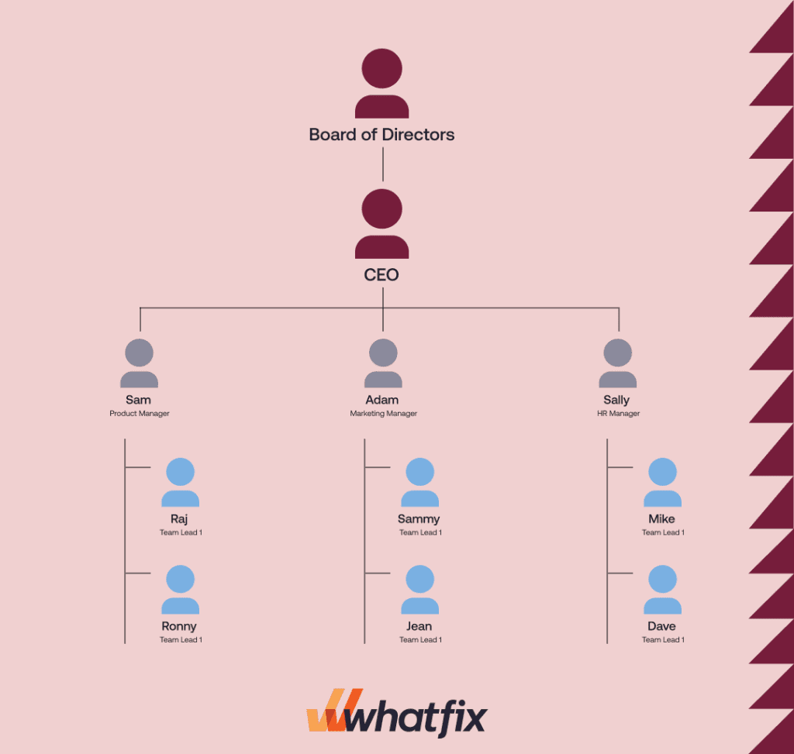

WHO ARE THE END USERS?

Slide 7

OUR SOLUTION AND ITS VALUE PROPOSITION:-
* Conditional formatting: It is used find the missing value
* Sort &filter: It is used remove missing value and to fill it.
* IPS: This formula is used for multiple condition
And to rate the employee performance through this formula
* Pivot table: It is used to summarize what we have done.
* Graph: This is used for visual

Slide 8
Dataset Description
Employee=kaggle
26 features
9 features
Employ Id : Number
Name: Text
Business unit: Text
Employee type: full time, contract, part time
Performance level: Very high, High,Med,Low
Gender: male, female

Slide 9

THE "WOW" IN OUR SOLUTION
3/21/2024 Annual Review
9

Slide 10
MODELLING
• Collecting the data , which we are going to use it.
• By selecting the column and filling with the colours. so that it can be identified.
• If there are missing numbers in the column,which we selected use conditional formatting to fill it .
• Click on the highlights in the more rules click on blank and choose format and click colour and choose what you want
• If you want to identify the missing value click on sort&filter to remove the blanks it fill the blank. Click on the column which has blank value& •click on sort &filter •In that click no fill to remove the blank
10

Slide 11
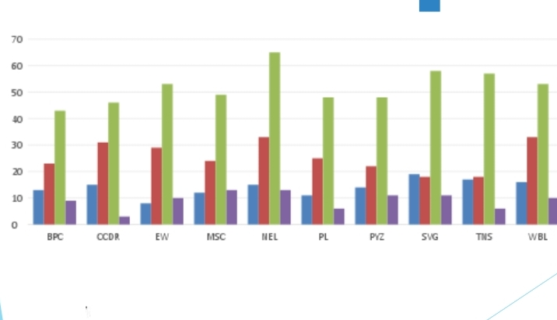
RESULTS
11

Slide 12
Conclusion
* From this analysing we come know about the employee performance by using excel .
* We also created pivot table for visualising and easy to understand.

